Slide 1
Project Tracker
April 26, 2018

Slide 2
Our Project
An app that keeps track of software development projects for BU students, allowing registered users and guests to create and search for others’ projects.
Hosted on: https://67.207.83.83/login

Slide 3
Team “Silver Serpent”
Ben Schwartz Group Lead
Chad Cover Configuration & Environment and Integration Lead
Andy O’Connell Implementation Lead
Kanishka Bagri QA Lead
Prabhakar Punj Lal Design Lead

Slide 4
Agenda
Requirement analysis (Parker)
Design (Chad)
Implementation ( Chad )
Testing (Kanishq)
Security (Andy)
Project management (Ben)
Demo (Parker)

Slide 5
Requirement analysis
Overview of functional requirements using use case diagram,
User stories
examples,
total number planned vs completed
total points
How your project track requirements and handle requirement changes
nonfunctional requirements

Slide 6
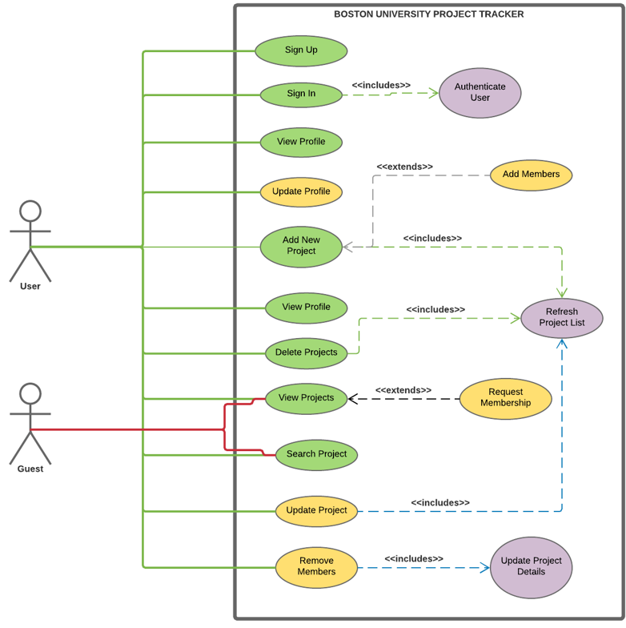
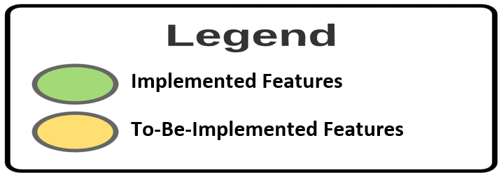
Use Case Diagram
Requirement analysis
Actors:
Registered User
Guest User

Slide 7
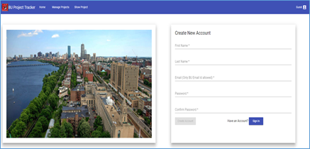
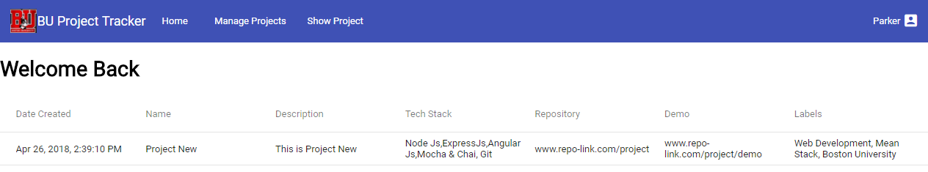
Project Overview - Completed Stories
A user should be able to Sign Up/ Create New Account.
Only BU Email Ids can be used to create a new account.
The Create button will be enabled only when all the fields are correct.
If the user don’t want to create an account and just want to browse through the projects he can continue as GUEST.
A user should be able to Sign In.
When user signs in he is redirected to the home page and all the projects created by him are displayed.

Slide 8
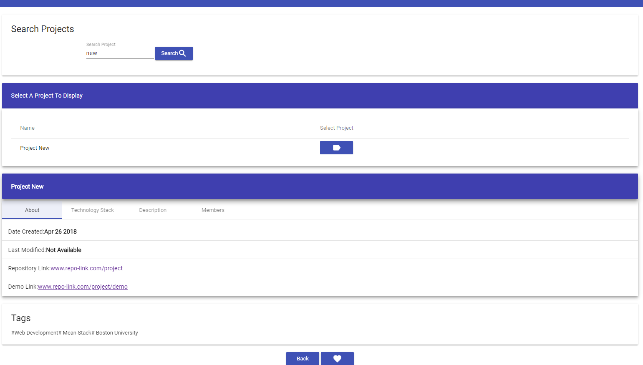
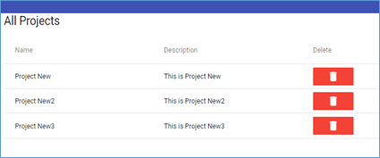
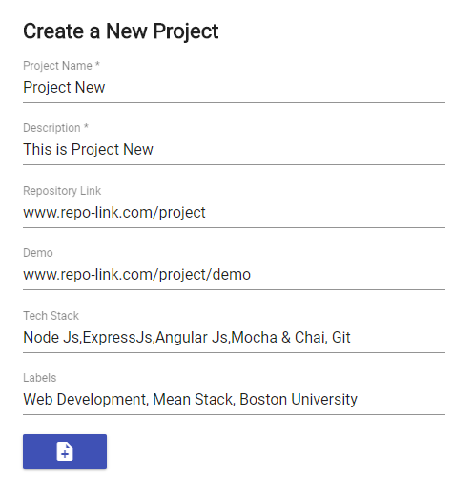
Project Overview - Completed Stories
A user should be able to delete a project.
This is the Manage Projects module where the user can delete the projects.
A user should be able to Manage Projects.
The user can add ,search, view and delete projects.
The above picture shows the Show Projects module where a user searches a project by name.
A user should be able to create a new project.
This module lets the user to create a new project.
A project can’t be created without a name and a description.

Slide 9
Non Functional Requirements
Alignment of the page elements, consistency of fonts, size and color of the page elements was taken care of.
Security- We used token based authentication, SSL Certificates and password hashing for added security.
Coding was done keeping reusability in mind.
Logs were created on nearly every step to facilitate debugging.
We divided the components into sub components to ease maintenance.

Slide 10
User Stories Statistics
Total Points Accepted | 32
Total Stories Accepted | 22
Total Stories Completed | 16
Total Stories Rejected | 0
Total Stories Remaining | 6
Total Features | 17
Total Bugs | 3

Slide 11
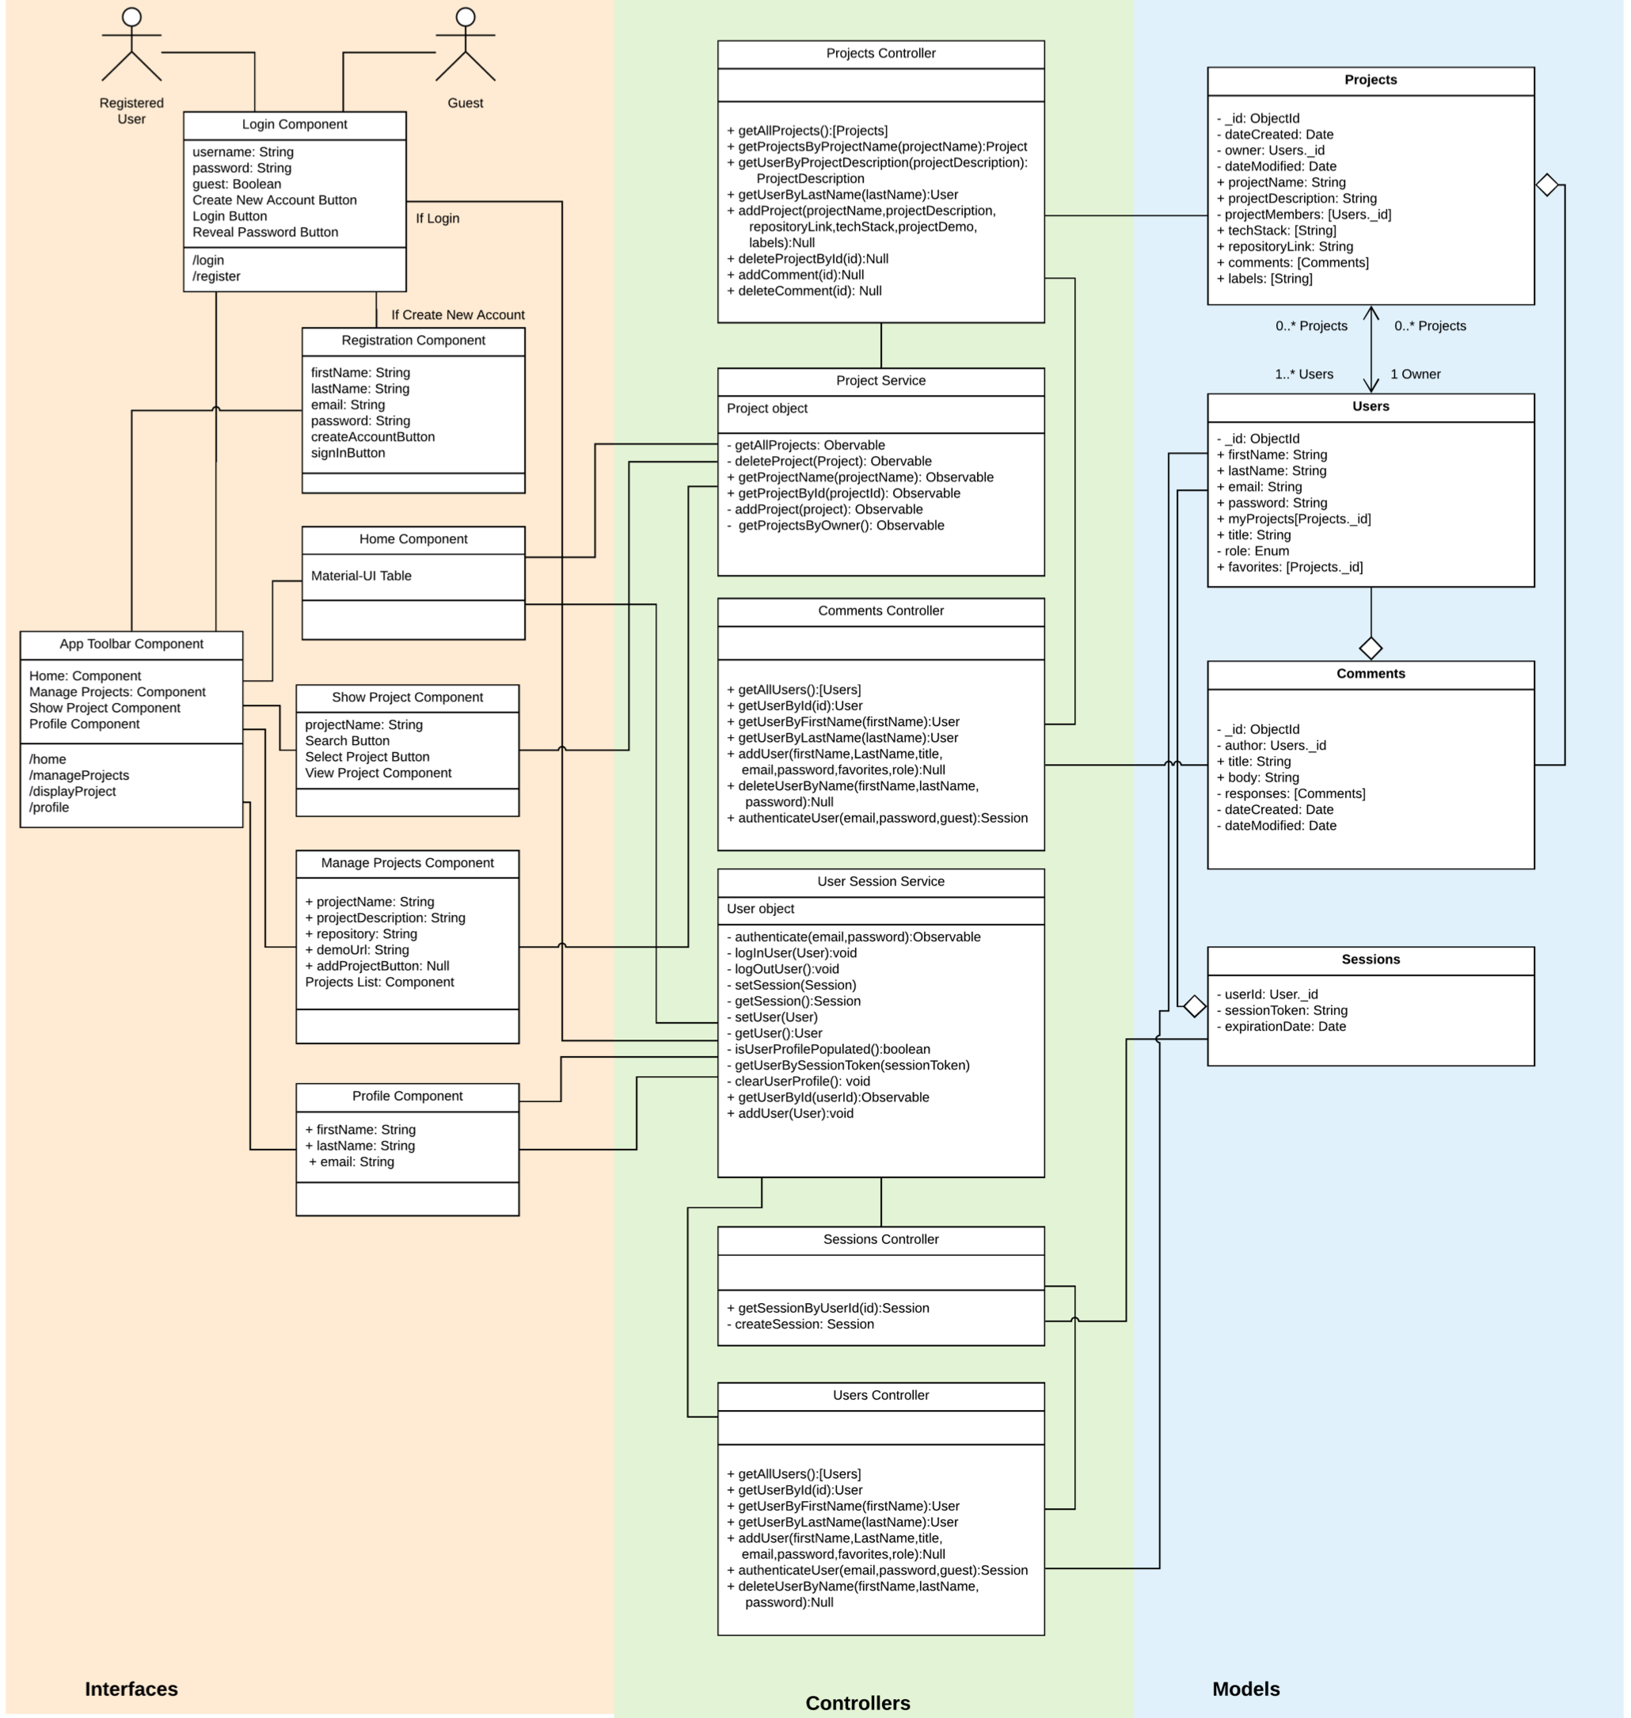
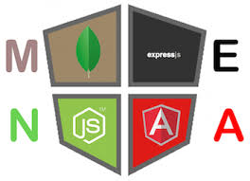
Design
Supplements
Mongoose
Material-UI
Mocha/Chai/Karma
Languages
Typescript
ES6
Plain Old JS5

Slide 12
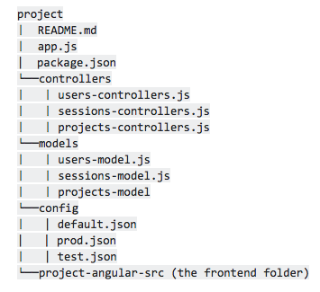
Implementation: Backend
app.js is the express server
// initialize app variable let app = express(); // declare port const restPort = 3000; const frontEndPort = 3001; // connect to database mongo.connect(config.dbHost); // error logging let db = mongo.connection; db.on('error', console.error.bind(console,'connection error:'));
////////////////// // Project Routes ///////////////// // add routes app.route("/project").post(projects.addProject); // search routes app.route('/projects').post(projects.getAllProjects); app.route('/project/projectName').post(projects.getProjectByProjectName); app.route('/project/projectDescription').post(projects.getProjectByProjectDescription);

Slide 13
Implementation: Backend
project-model is the . . . err . . . database model.
const ProjectsSchema = mongo.Schema({ dateCreated: { type: Date, required: true }, dateModified: { type: Date }, projectName: { type: String, required: true }, projectDescription: { type: String, required: true }, owner: { type: ObjectId, ref: 'User', required: true }, // more here }); const Project = module.exports = mongo.model('Project',ProjectsSchema);

Slide 14
Implementation: Backend
projects-controller is the controller
let express = require('express'); let Project = require('../models/projects-model'); var ObjectId = require('mongodb').ObjectId;
addProject = (request, response) => { let dateCreated = new Date(Date.now()); new Project( { dateCreated: dateCreated, projectName: request.body.projectName, projectDescription: request.body.projectDescription, projectMembers: request.body.projectMembers, repositoryLink: request.body.repositoryLink, owner: request.body.owner, techStack: request.body.techStack, projectDemo: request.body.projectDemo, labels: request.body.labels } ).save((error, project) => { if (error) { response.json({success: false, message: `Failed to create a new list. Error: ${error}`}); } else { response.json({success: true, message: "Project added successfully."}); } });

Slide 15
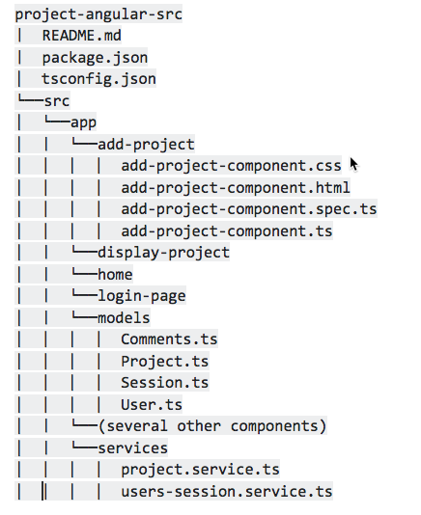
Implementation: Frontend
Each Angular component is self-contained
<!-- add-project-component.html --> <mat-card> <mat-card-title>Create a New Project</mat-card-title> <form *ngIf="userIsAuthorized" #newProjectForm (keyup)="updateFormValid()" (ngSubmit)="onCreateNewProject()"> <mat-form-field> <input matInput placeholder="Project Name" [(ngModel)]="newProject.projectName" name="projectName" required> </mat-form-field> <mat-form-field> <input matInput placeholder="Description" [(ngModel)]="newProject.projectDescription" name="projectDescription" required> </mat-form-field>
<!-- add-project-component.ts → onCreateNewProject() { var proj = { dateCreated: new Date(), dateModified: new Date(), owner: this.newProject.owner, projectName: this.newProject.projectName, projectDescription: this.newProject.projectDescription, projectMembers: this.parseString(this.newProject.projectMembers), techStack: this.parseString(this.newProject.techStack), repositoryLink: this.newProject.repositoryLink, projectDemo: this.newProject.projectDemo, labels: this.parseString(this.newProject.labels), _id: '' } this.projectService.addProject(proj).subscribe( response => { this.projectAdded.emit(this.newProject); this.createEmptyProject(); this.formIsValid = false; }); }

Slide 16
Implementation: Frontend
Components subscribe to services
Services communicate with the controllers via the routes.
@Injectable() export class ProjectService { baseURL = 'https://67.207.83.83:3000'; //baseURL = 'https://localhost:3000'; constructor(private http: HttpClient, private userSessionService: UserSessionService) {} getAllProjects(): Observable<Project[]> { const url = `${this.baseURL}/projects`; return this.http.post<Project[]>(url, undefined); } deleteProject(project: Project): Observable<any>{ const url = `${this.baseURL}/project/delete` return this.http.post(url, project); }

Slide 17

Production Environment
Deployed to a MEAN stack on Digital Ocean
Ubuntu 16.04 cloud server
Installed Node and Git
Compiled and installed MongoDB from source
Other dependencies installed via NPM per package.json
MongoDB run by a specific user with non-admin privileges
MongoDB authentication required
DB configuration done only on production server; no info in GitHub
Secure frontend & backend
Self-signed SSL certificate
Built and serve a static website using Webpack

Slide 18
Testing
Types of Testing:
Unit Testing
Integrated Testing
System Testing
Ad-hoc Testing
Usability Testing
Some Highlights:
Integration Testing and System Testing revealed a lot of defects which were addressed in this sprint
Discovered a number of new defects Ad-Hoc testing on the deployed environment
Usability testing helped identify and improve the overall user experience
Automation coverage helped ensure regressions were not being introduced in the project

Slide 19
Testing (contd..)
Test Case Management / Defect Management
Tracking via Google Sheet
Documenting the following for each reported Bug - Summary, STRs, Reporter, Owner, Severity, and Status
Defect Status:
Count of Defect Reported: 35
Defect Re-opened: 5
Current Open Defect: 4

Slide 20
Testing Metrics
Test Case Management | Iteration 1 | Iteration 2 | Iteration 3 | Final
Number Of Test Cases Added | 8 | 22 | 24 | 54
Number of Test Cases Executed | 8 | 22 | 24 | 54
Pass | 8 | 19 | 18 | 50
Fail | 0 | 3 | 6 | 4
Pass Percentage | 100 % | 86 % | 75 % | 92 %
Automation
API/Unit Tests/UI | 3 | 19 | 0 | 22

Slide 21
Security Key Highlights
User Authentication
End to End Encryption
Rest
Anguler
Access Controls for Unauthorized Users
Certificate Authority Signing

Slide 22
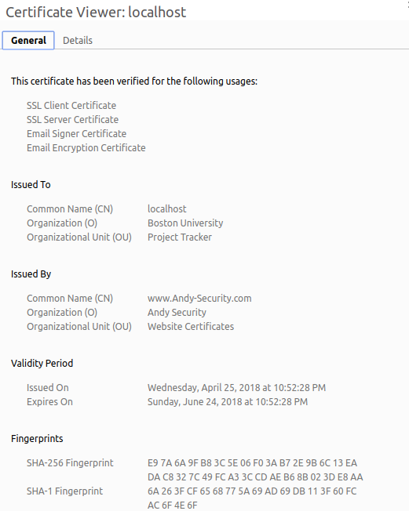
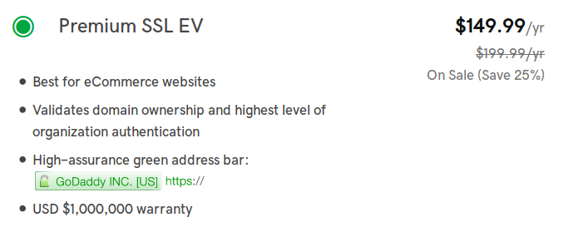
Security Processes and Techniques
Extensive Use of Strongly Encrypted SSL Certificates
Public Key Cryptography Standards
PKCS #1 SHA With RSA Encryption
8192 bit Modulus Public Key
SHA512
Created a Self Signed Certificate
Acted as the Issuer due to the cost of getting an official Cert
Create a root Certificate associated with the System then use
~$150 a year for equivalent Cert from GoDaddy.com
Angular Front End sits on HTTPS on 443
Rest Endpoints reside on port 3000

Slide 23
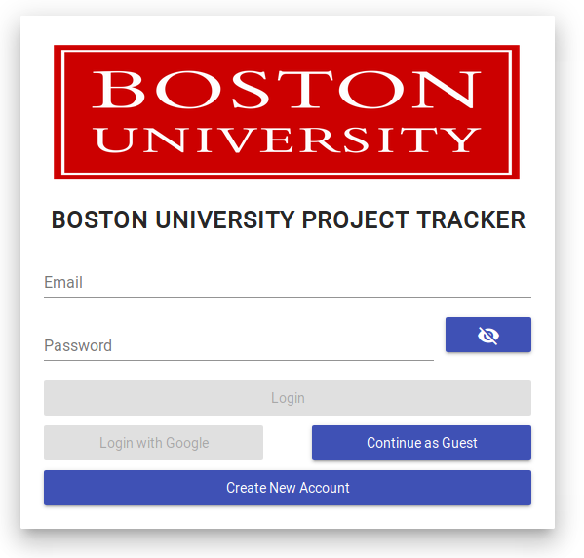
Security User Authentication
Open Web Application Security Project (OWASP)
User is restricted by Form Validation
Only BU email address are given access
Passwords must be 8-12 Chars in length
All password are saved as an SHA256 Hash in the database

Slide 24
Security User Authentication
Angular
Express
MongoDb
User
loginPage(email, password)
authenticateUser(email, password)
findUser(email)
User
SHA256(password) == User.password?
createSession(User.id)
Session
Session
getUserBySessionToken(token)
getUserBySession(token)
User
User
Router(‘Home’)
User

Slide 25
Project management
Role assignment as well as individual contribution,
Risk management,
Quality management and quality metrics collected throughout the project,
Process improvement,
Iteration evolution,
Achievements of the project
UserAuth
Access Controls
HTTPS
Create, Delete
Challenges in the project
Learning Curve
MEAN Stack is Complicated
Lesson learned.

Slide 26
Workflow that our team followed
Brainstorming
The team used to discuss a new idea on every Thursday and then the team members mulled over that idea until Monday’s meeting.
The idea was then discussed in detail on Monday’s meeting and implementation for that idea/feature was discussed.
2) Role Assignment
After discussing what need to be done and we would assign different roles to the team members who were require to finish them by next meeting.
On the next meeting we would discuss the progress of the project and the problems that the team members faced during working on those features.
Members would stay for additional time after the meeting to ensure that the issue/ has been fully resolved.
3) Contribution
After the feature is ready and tested locally by the developer, he pushed it to the GitHub for other member to test on their machines where they would test the code for quality and bugs.
When approved, the code would then be merged with the master branch.

Slide 27
THANK YOU

Slide 28
DEMO TIME

